Slide 1

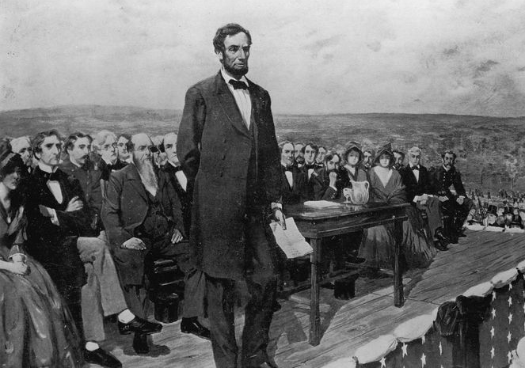
Presidential Speeches
IST 736 – Final Project Drew Howell and Nash Delcamp

Slide 2
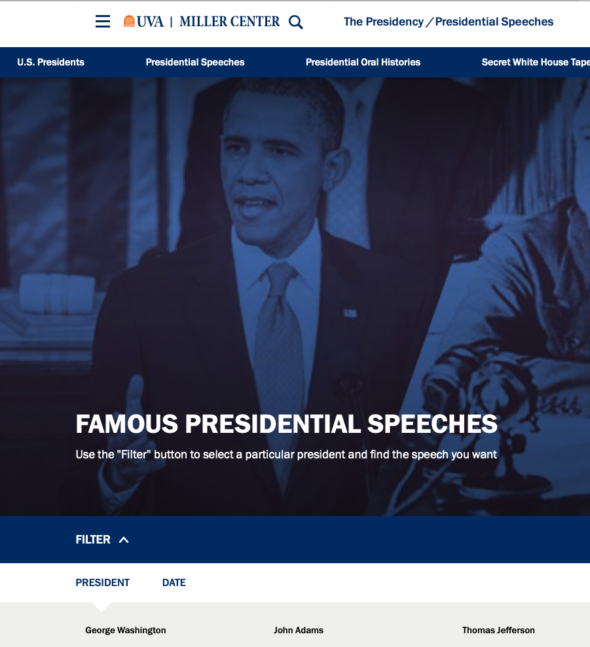
Introduction
Presidential addresses to the public are important and meticulously worded
What can we learn through text mining to better understand our leaders?
The data: The Miller Center’s transcripts of each president’s top three speeches along with metadata per president
Notes:
Every direct and formal address to the public by the president is very important
Couldn’t find any other projects with a quick search online that used text mining to analyze speeches
Trying to see if text mining can offer any deeper insight into how I favorite presidents stand out, the general sentiment of parties, etc.
Describe third bullet
Besides this being interesting per se, it might also help us evaluate our current leader based on his speeches in an analytical and fact-based way.

Slide 3
Top TF-IDF Words
Places
Panama
Japanese
Greece
Iraq
Economical Forces
Bank
Harvest
Coalition
Big Actions
Dedicated
Advice
Rebellion
Applause

Slide 4
Sentiment Over Time (vaderSentiment)
Increasing variance in 20th century
Positive range = 0.14
0.34 - 0.2
Negative range = 0.075
0.15 – 0.075
Trend line increases for both

Slide 5
K-means
Cluster | Avg. Date | Avg. Word Count | Avg. Neg Score | Avg. Pos Score | Avg. Term Length | Speeches | Democrat | Republican | Other Party
1 | 1969 | 1501 | 0.124 | 0.268 | 5.45 | 47 | 40% | 51% | 9%
2 | 1867 | 2217 | 0.093 | 0.239 | 4.62 | 75 | 27% | 37% | 36%
Group 1: New School
Average speech is 50 y/o
2-party system
Shorter and poignant
Group 2: Old School
Average speech is 150 y/o
Several parties
Long-winded and boring (less emotional)
Cluster | Avg. Date | Avg. Word Count | Avg. Neg Score | Avg. Pos Score | Avg. Term Length | Speeches | Democrat | Republican | Other Party
1 | 1868 | 5553 | 0.080 | 0.219 | 4.30 | 15 | 13% | 47% | 40%
2 | 1974 | 1533 | 0.121 | 0.269 | 4.67 | 43 | 37% | 56% | 7%
3 | 1853 | 1264 | 0.093 | 0.190 | 5.59 | 20 | 40% | 20% | 40%
4 | 1876 | 1416 | 0.103 | 0.269 | 4.60 | 44 | 30% | 39% | 32%
Group 1: Please Stop Talking
Long, dry speeches
Group 2: New School (Again)
Replica of k2,G1
Most distinct cluster
Group 3: The Quick And Easy Liberals
Short speeches
Least variance of sentiment
Lowest sent in both categories
Group 4: Emotional Old Men
Every Lincoln speech
Largest sentiment variance

Slide 6
K-means, Presidential Distribution
Group 1
Group 2

Slide 7
K-means, Presidential Distribution
Group 1
Group 3
Group 2
Group 4

Slide 8
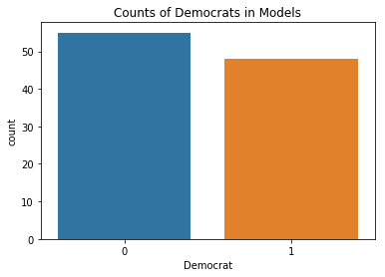
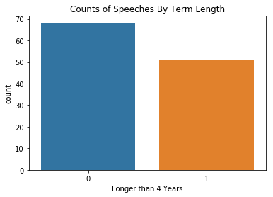
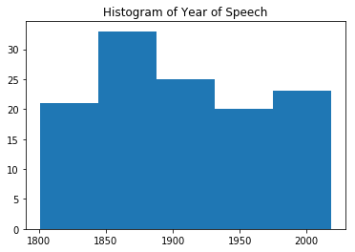
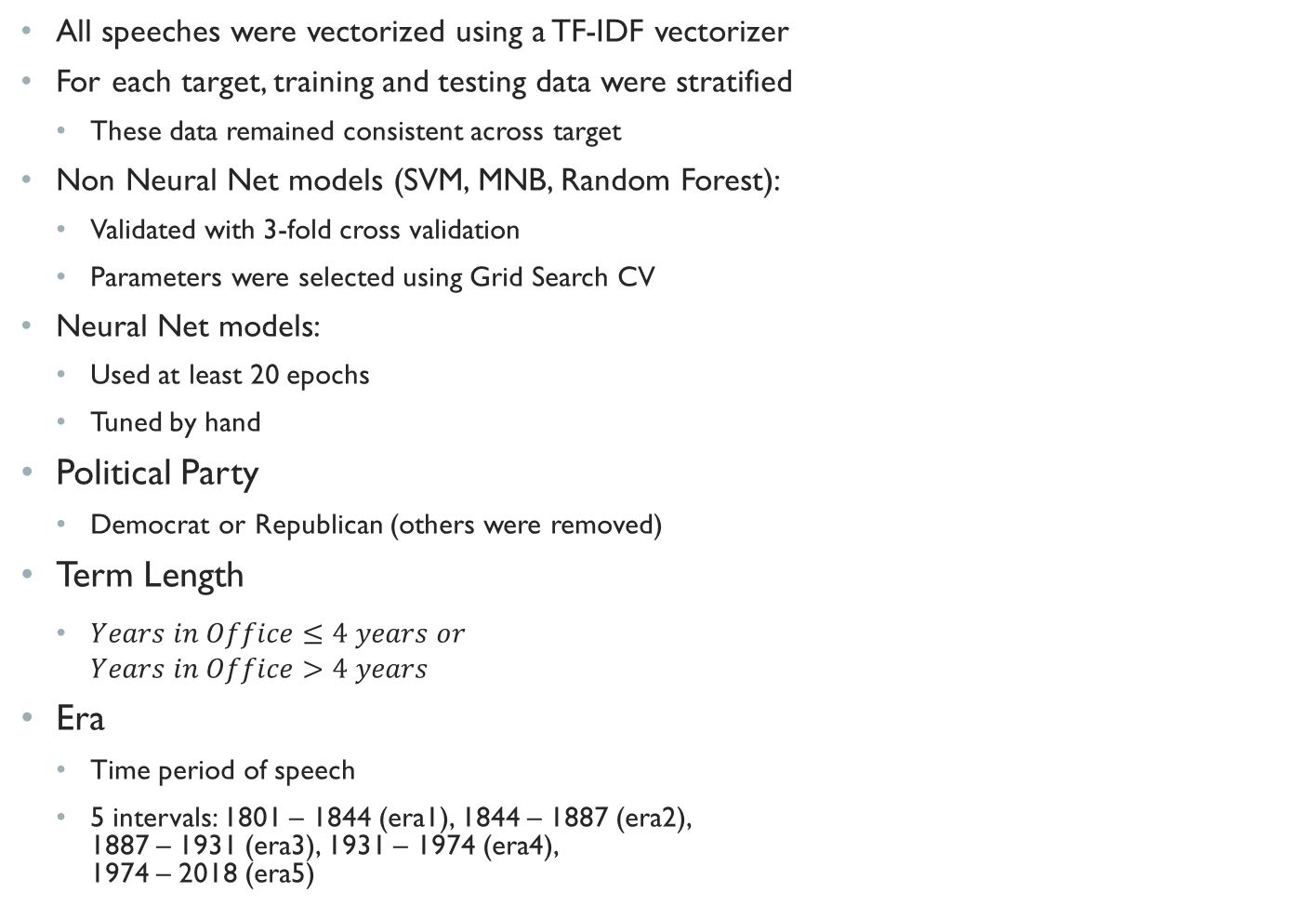
Prediction Models
All speeches were vectorized using a TF-IDF vectorizer
For each target, training and testing data were stratified
These data remained consistent across target
Non Neural Net models (SVM, MNB, Random Forest):
Validated with 3-fold cross validation
Parameters were selected using Grid Search CV
Neural Net models:
Used at least 20 epochs
Tuned by hand
Political Party
Democrat or Republican (others were removed)
Term Length
$Years in Office≤4 years or$ $Years in Office>4 years$
Era
Time period of speech
5 intervals: 1801 – 1844 (era1), 1844 – 1887 (era2), 1887 – 1931 (era3), 1931 – 1974 (era4), 1974 – 2018 (era5)

Slide 9
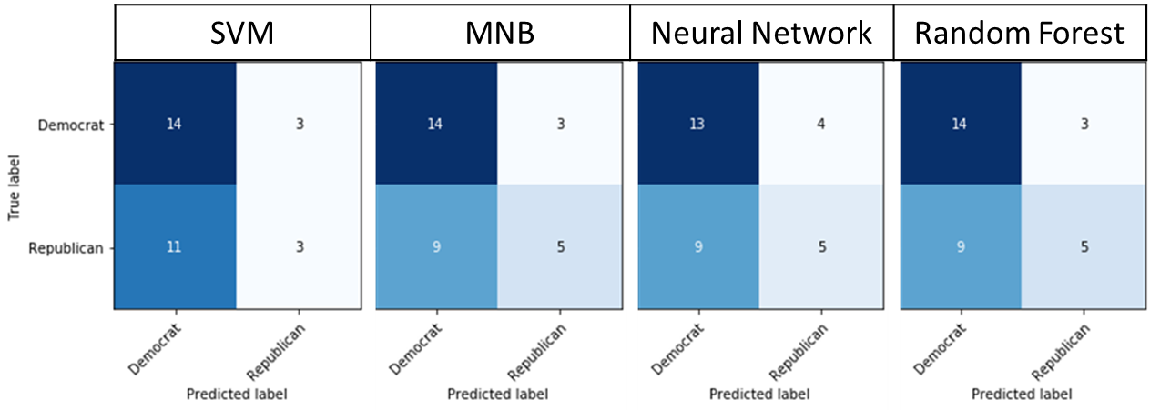
Predicting Political Party Base Accuracy = 0.548
Model | Parameters | Test Accuracy | Precision | Recall | F1- score
SVM | C = 100 | 0.548 | 0.53 | 0.52 | 0.48
MNB | alpha = 10⁻⁶ | 0.613 | 0.62 | 0.59 | 0.58
Neural Network | Dense relu, 50 Dense softmax, 2 epochs = 20 | 0.581 | 0.57 | 0.56 | 0.55
Random Forest | max_depth = 10 max_features = log2 | 0.613 | 0.62 | 0.59 | 0.58
Notes:
Relu is Rectified Linear Unit.
Softmax is Softmax activation function.
Max_features is the number of features to consider when looking for the best split. Log2 means log2(n_features)

Slide 10
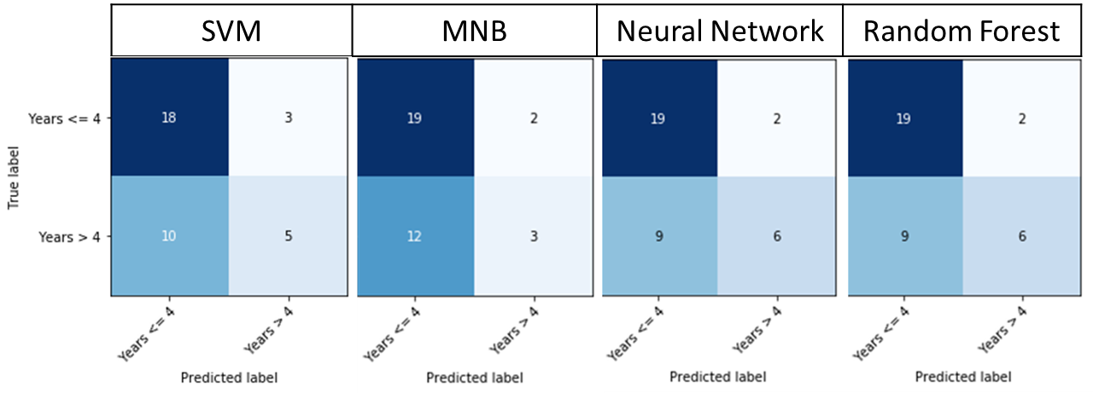
Predicting Term Length Base Accuracy = 0.583
Model | Parameters | Test Accuracy | Precision | Recall | F1- score
SVM | C = 200 | 0.638 | 0.63 | 0.60 | 0.58
MNB | alpha = 10⁻⁶ | 0.611 | 0.61 | 0.55 | 0.52
Neural Network | Dense relu, 200 Dense softmax, 2 epochs = 40 | 0.694 | 0.71 | 0.65 | 0.65
Random Forest | max_depth = 35 max_features = auto | 0.694 | 0.71 | 0.65 | 0.65

Slide 11
Trump Years in Office Neural Network Prediction
Date | Speech | Probability In Office <= 4 | Probability In Office > 4
1/20/2017 | Inaugural Address | 0.315 | 0.685
2/28/2017 | Address Joint Session Congress | 0.497 | 0.503
1/30/2018 | State Union Address | 0.536 | 0.464

Slide 12
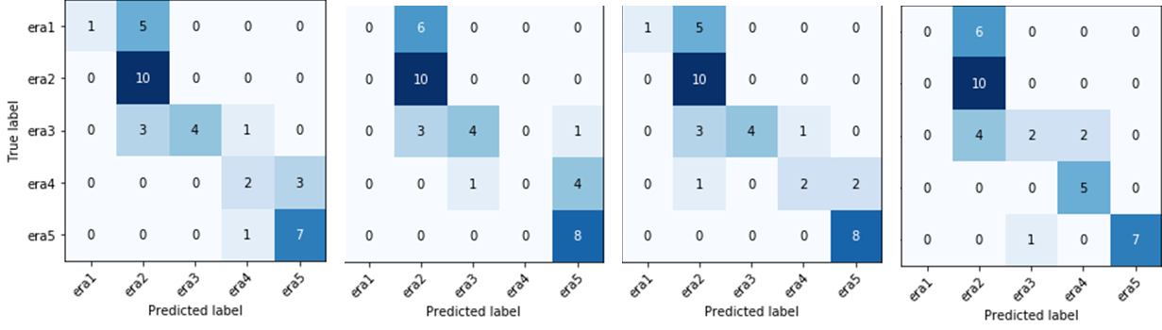
Predicting Time Period Base Accuracy = 0.270
Model | Parameters | Test Accuracy | Precision | Recall | F1- score
SVM | C = 200 | 0.649 | 0.75 | 0.59 | 0.58
MNB | alpha = 10⁻⁶ | 0.595 | 0.39 | 0.50 | 0.41
Neural Network | Dense relu, 800 Dense softmax, 6 epochs = 45 | 0.676 | 0.80 | 0.61 | 0.61
Random Forest | max_depth = 70 max_features = None | 0.649 | 0.58 | 0.62 | 0.56
SVM | MNB | Neural Network | Random Forest

Slide 13
Questions

